Slide 1

The 2018 US-China Trade Conflict After 40 Years of Special Protection
Chad P. Bown
Jason Qiao

Slide 2
Outline
1980
2017
Beginning of Trade War
2018
Trump Administration- $250 billion tariffs
2019
2001
Granted China normal MFN Tariffs
China’s in WTO
The 2018 US-China Trade Conflict After 40 Years of Special Protection
The Trade War is Suddenly Getting Worse

Slide 3
Goal
Learn the trade relationship between the two countries before 2018
  -Key Events, More focus on underlying US political-economic concern with China, as well as WTO, that triggered the events of 2018
Assess what happened during 2018
  -Whether China’s state-owned enterprises (SOEs) and industrial subsidies, as well as China’s development strategy and system of forcibly acquiring foreign technology, were imposing increasing large costs on trading partners
  -Whether the US Strategy to provoke a crisis-which may result in a severely weakened World Trade Organization-was deliberate and out of frustration with the institution itself
Review what happened recently (2019)
Notes:
Little Focus

Slide 4
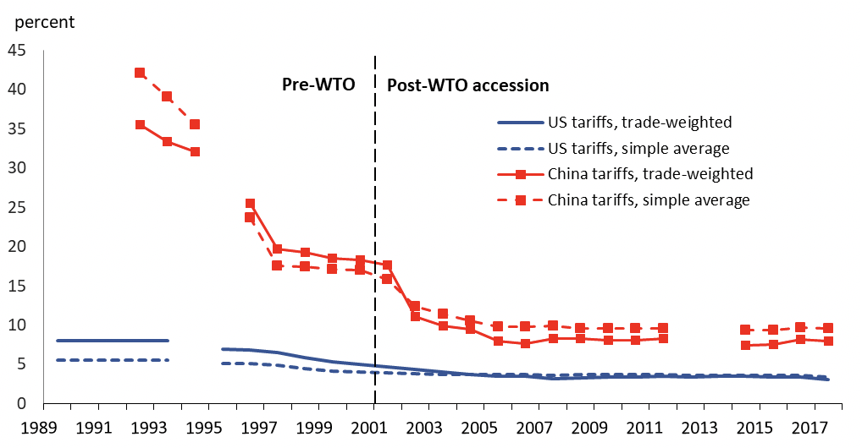
Normal Tariff on U.S Imports from China is low, Before 2018
US and China’s bilateral applied tariffs, 1989–2017
General Agreement on Tariffs and Trade (GATT)
Most-Favored Nation(MFN) Tariff (China in)
Generalized Preference System (GPS)
3%
* Constructed by the author with applied MFN tariff and export data at the 6-digit Harmonized System level made available from World Bank World Integrated Trade Solution database.
Notes:
MFN Tariffs, Equal treatment of all countries

Slide 5
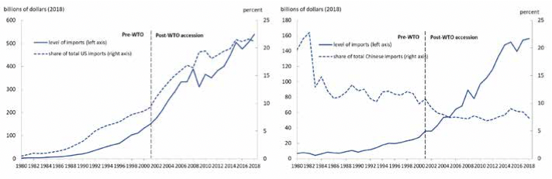
US Imports from China Grew Faster Than China Imports from US, 1980-2018
US Imports From China
China Imports From US
*Source: Bilateral trade data derive from the IMF Direction of Trade Statistics. Converted to 2018 constant dollars using import and export price indices from Bureau of Labor Statistics.

Slide 6
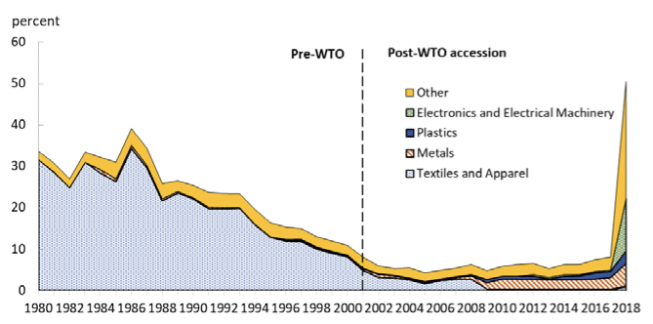
US Approach - Special Protection
Tariffs
Quantitative Limit on imports or negotiated as a voluntary restraint on a trading partner’s exports
US imports from China covered by special protection by sector, 1980–2018
Granted China normal MFN Tariffs
Multifibre Arrangement (MFA)
Trump’s Administration

Slide 7
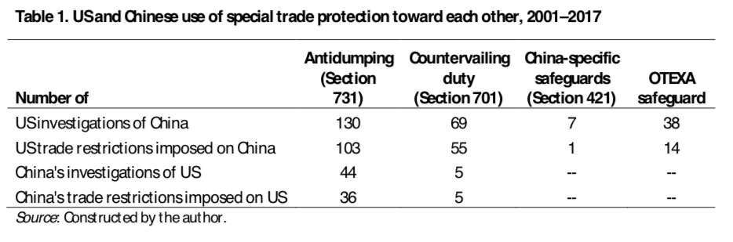
US Escalated Special Protection, 2001-2017
Trigger – labor union claimed they were injured due to import competition
New Policies
  Restrain imports of clothing and textile products
  Antidumping and countervailing duty investigations

Slide 8
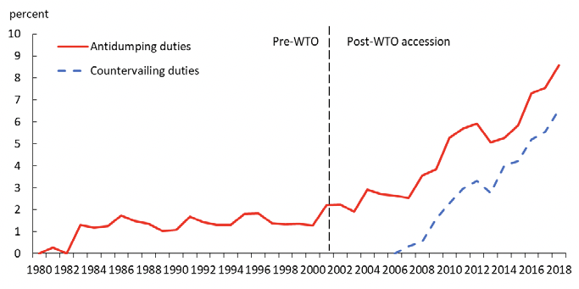
US imports from China covered by antidumping and countervailing duties, 1980–2018
”The redundancy of the antidumping and countervailing duty cases against China is worth nothing” - Chad
There are offset adjustments to the tariffs for the products over which antidumping and countervailing duties are simultaneously applied; i.e., the overall tariff is not simply the sum of the two individual duties.

Slide 9
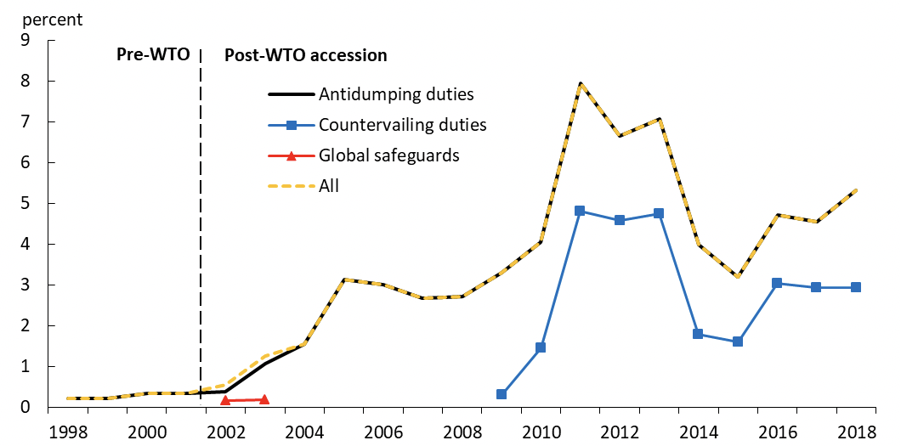
China Approach, Before 2018
China’s imports from US covered by antidumping, countervailing duties, and safeguards, 1998–2018
Retaliation against US Section 421 safeguard

Slide 10
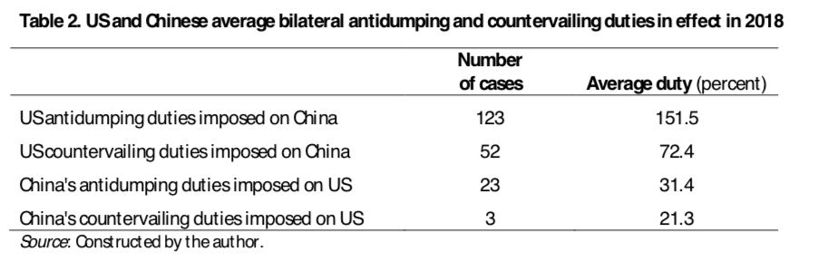
Antidumping and Countervailing duties, 2018

Slide 11
U.S Opinion
“The United States hasn’t had a Trade Surplus with China in 40 years. They must end unfair trade, take down barriers and charge only Reciprocal Tariffs. The U.S. is losing $500 Billion a year, and has been losing Billions of Dollars for decades. Cannot continue!”
  ---------- President Donald Trump’s tweet of April 8, 2018,
Multinational companies complained more and more about being mistreated in China
Were being forced to transfer their technology to Chinese firms on non-commercial grounds or in some cases even having it stolen

Slide 12
Special Protection Key Events, 2018
Additional $100 billion
US
25% on steel; 10% on aluminum
Negotiations, hold for 90 days
Investigation into steel, aluminum, solar panels
$50 billion, 25% Tariffs
Additional $200 billion
2017 2018 March April June August December
China
15%-25% on $2.4 billion imports
$60 billion, 5%-25% Tariffs
$50 billion, 25% Tariffs

Slide 13
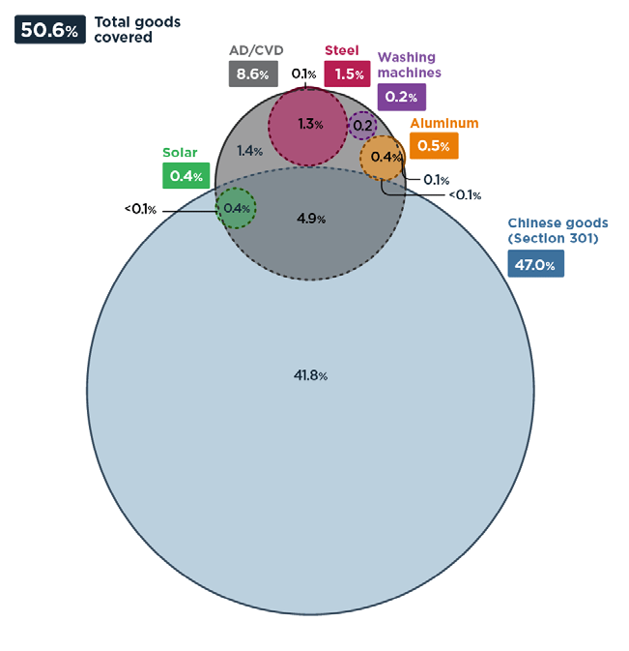
US Imports from China Covered by Special Tariffs in Effect in 2018

Slide 14
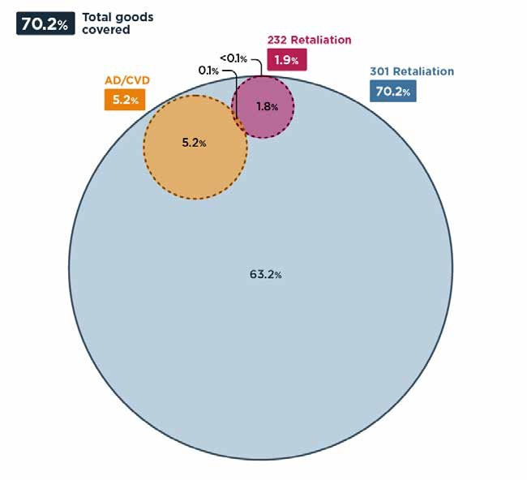
China’s Retaliation in 2018
Chinese imports from US covered by special tariffs in effect in 2018 (percent)
$110 billion, 70% of China’s total goods imports from the U.S. Some of them are already subject to China’s antidumping or countervailing duties

Slide 15
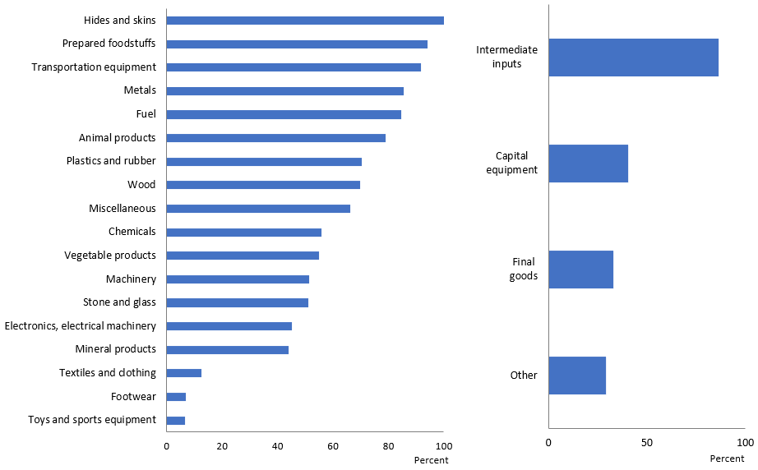
US 2018 Special Protection, by product type and sector
By Sector
By Product type
90 Percent of US imports of intermediate inputs from China threatened American producers’ continued integration with international supply chains, improving the global competitiveness of their domestic firms

Slide 16
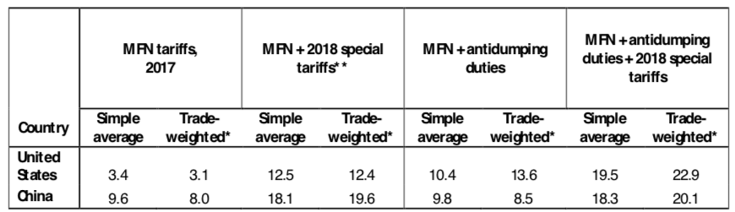
US and China’s bilateral tariffs before and after the 2018 acts of protection (percent)

Slide 17
Major U.S Concerns
China’s nonmarket economy
Political-Economic Concern - China’s Industrial Subsidies
Transfer of the Technology
WTO’s inefficiency to address China’s problem

Slide 18
China, a nonmarket Economy
  After its 2001 WTO accession, China did not fully transform into a market economy ---- China’s system of explicit and implicit subsidies imposed political-economy costs on trading partners
  Aluminum – China subsidies (SOEs)
    Aluminum doubled between 2005-2017, China was the source of most expansion
  Chinese firms in the aluminum industry are the top beneficiaries of direct and indirect government support (subsidies, below market-rate loans, tax concessions)
    Price of coal (input cost of aluminum) elevated during 2011-2015. Government support not market signals

Slide 19
Aluminum as an Example
Chinese Government
Upstream Aluminum
Downstream Aluminum
Export to U.S and other countries
Global competition to foreign country's domestic firms
Negative shock to global demand might result in unemployment and bankruptcy in other countries such as the U.S
Production
Products & Sales

Slide 20
Transfer of Technology
US Stand Point
China Stand Point
Foreign companies locate production in China
Joint Ventures with local partners
Share resources
Transfer technology involuntarily
China high import tariffs
China’s tariff commitments were negotiated as part of its WTO accession
China had been phasing out its joint venture requirements, and limits on foreign investment remained in fewer sectors.
Even if Chinese government lifted formal requirements that foreign firms must partner with local firms, other policies could continue to incentivize joint ventures.

Slide 21
Other Concerns – at the WTO
WTO issued several dispute settlement rulings that constrained how the United States was legally able to respond to injurious imports
US: “It should include upstream, state-owned enterprises such as banks, energy companies, other key input providers, and perhaps even firms with Chinese communist party officials in key management positions
WTO: The WTO’s subsidy disciplines can easily capture direct payments from a government agency to firms
China: Chinese subsidies arose instead from a nuanced and complex combination of policies that were not necessarily WTO-illegal when viewed in isolation
US Tariffs against China alone were insufficient to address the larger systemic concerns with Chinese subsidies
  The U.S argued that it imposed the 2018 tariffs because something needed to be done, even if it led to a crisis, because other WTO approaches were not addressing the underlying China subsidy problem.

Slide 22
Key Points
The US view of the overall trend was that China had continually pursued policies that operated in grey areas of the WTO, a system with rules better built to mediate trade cooperation between market economies.
  China’s economic size imposed unsustainable political-economic costs on trading partners
The existing WTO system could no longer address the political-economic costs that China’s system imposed on others.
  There was considerable uncertainty as to whether any one-off dispute was even winnable, and the long-run strategy risked being ineffective.
The Trump administration provoked a crisis in 2018, and its destructive tactics have resulted in considerable short-run economic costs
Future research in evaluating the costs of Chinese policies for the U.S. is important to address the conflict.

Slide 23
The Trade War is Suddenly Getting Worse

Slide 24
2019
2018 Tariffs in effective
US
25% on steel; 10% on aluminum
Additional $100 billion
Negotiations, hold for 90 days
$300 Billion, 15%
Investigation into steel, aluminum, solar panels
$50 billion, 25% Tariffs
Additional $200 billion
2017 2018 March April June August December
$75 Billion, 15%
China
15%-25% on $2.4 billion imports
$60 billion, 5%-25% Tariffs
$50 billion, 25% Tariffs

Slide 25
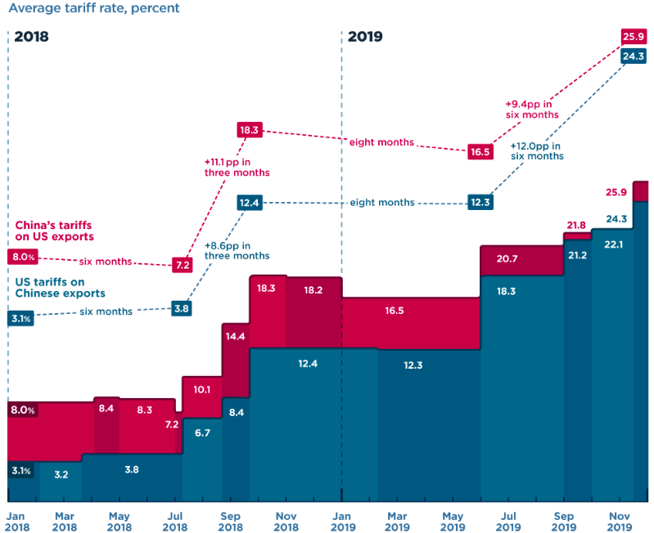

Slide 26
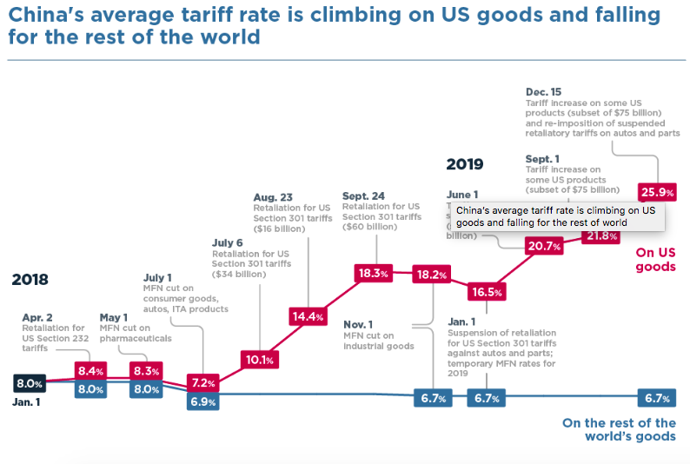

Slide 27
Effect on Global Economy
For U.S., A meaningful slowdown in domestic demand from the trade dispute may lead to rate cuts. Economic confidence among small U.S. companies fell in August to the lowest level since November 2012
For China, the key risk is that the combined effects of investment restrictions, export controls, and tariffs will rewire supply chains and weaken manufacturing investment, particularly in the technology sectors driving growth. GDP is estimated to grow lower than 6%
In Europe, the direct effects of U.S. – China trade friction will be felt in sectors with medium to high technological content like transport equipment, motor vehicles, rubber and plastics, chemical products, and pharmaceuticals
Japan, the capital spending by the country’s manufacturers fell 6.9% in the April-June quarter, the first decline in two years, as companies grappled with a nearly double-digit decline in exports to China
South Korea’s exports to China fell 21.3% in August compared with the same month a year earlier, driving an overall 13.6% decline in exports

